Slide 1
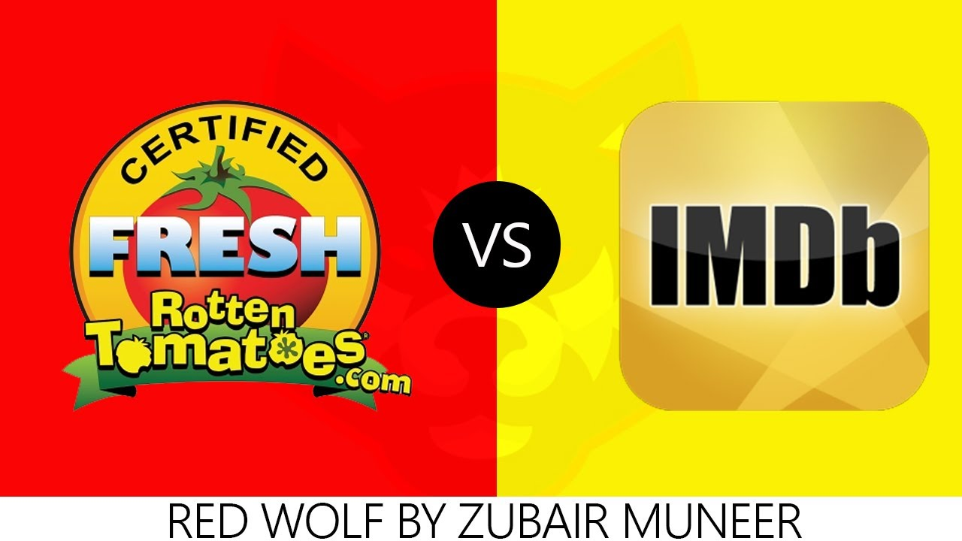
Imdb vs. Rotten tomatoes
Bird

Slide 2



Workflow
Clean and Join
Selenium search movie titles
Selenium
Scrape Http
Scrapy Shell
Notes:
Need MORPH TRANSITION FROM 5G driver

Slide 3
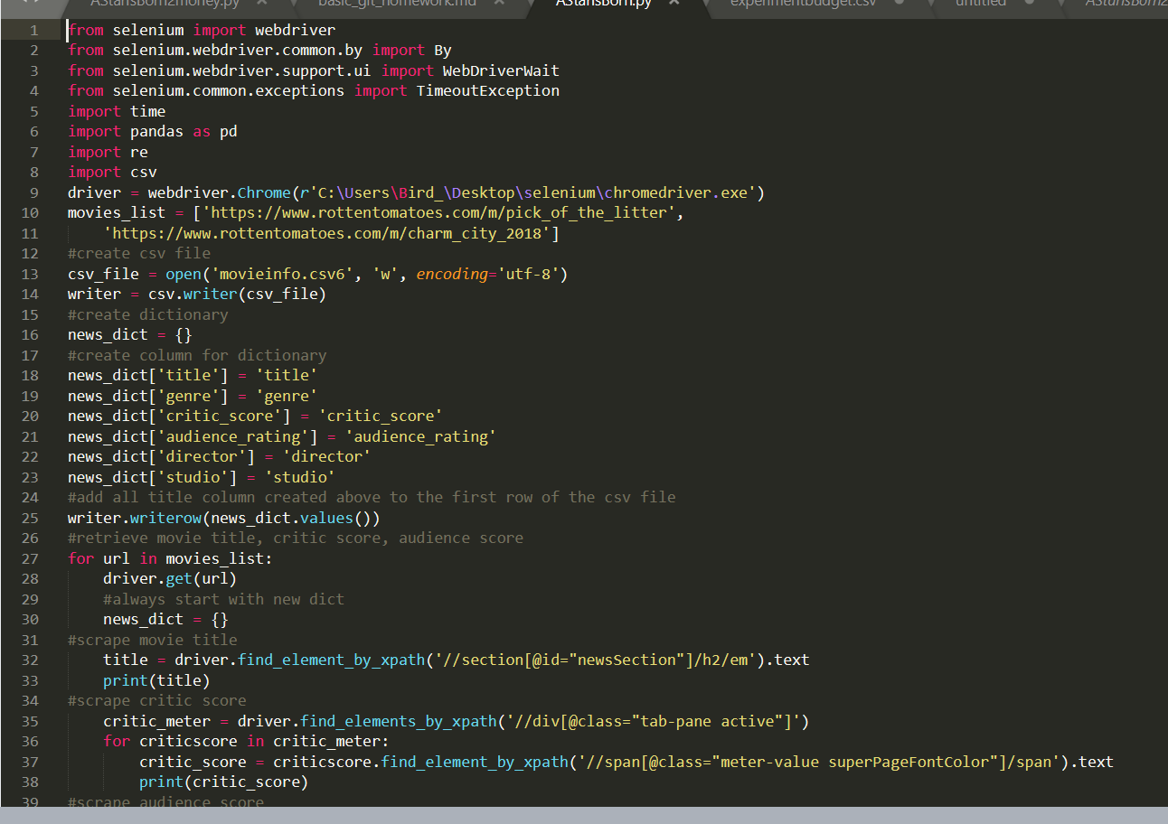
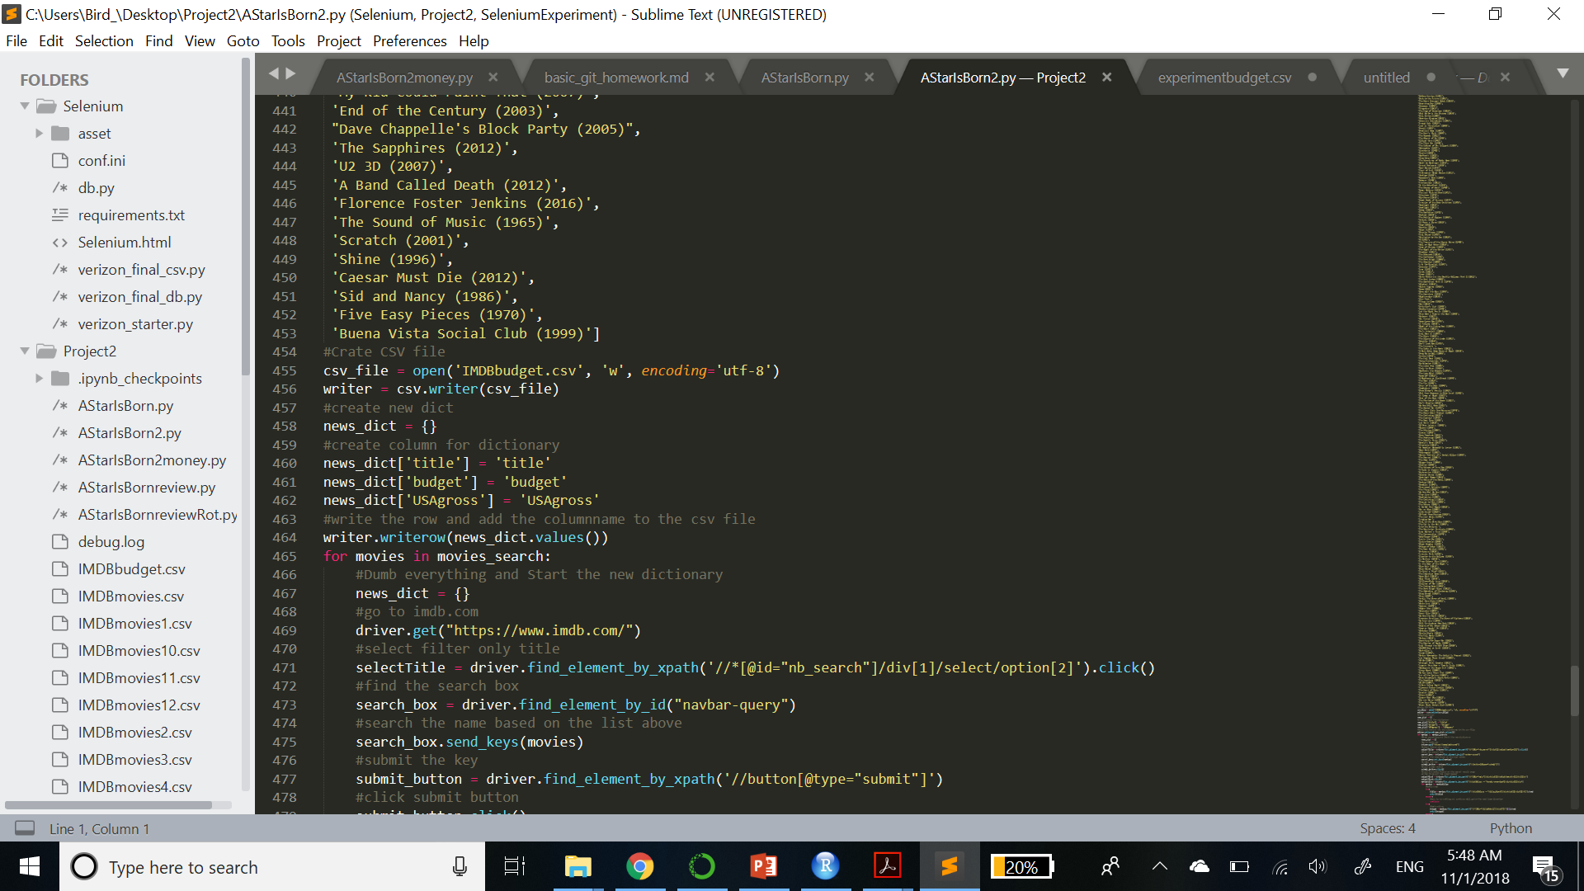
Example of Codes

Slide 4
Starting Question: Are there differences b/w imdb and rotten-tomato rating for both critic and audience?

Slide 5
Hypothesis Testing & Correlation

Slide 6
Shiny

Slide 7
Result1: T-Test (Two-Sided) – Critic Rating
Critic:
No Differences in rating b/w IMDB and ROT

Slide 8
Result2: T-Test (Two-sided) – Audience Rating
Audience:
No Differences in rating b/w IMDB and ROT

Slide 9
Result3: Interesting Fact for further investigation
Rating doesn’t affect Gross Profit

Slide 10
4 Things to improve

Slide 11

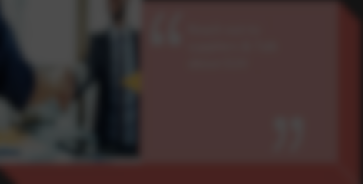

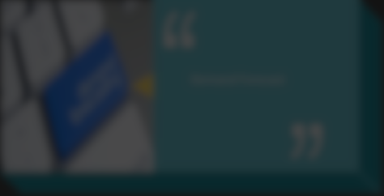
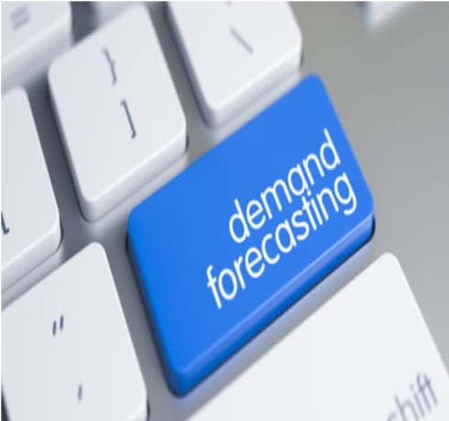
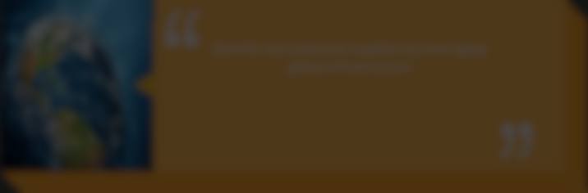

4 Things to improve
Keep improving on Shiny
Reach out to suppliers & Talk about EUV
Identify new potential suppliers by leveraging global infrastructure
Demand Forecast

Slide 12

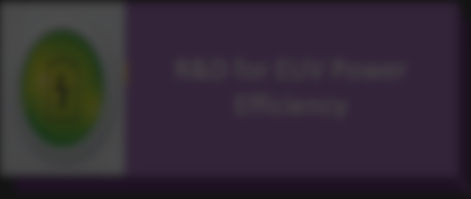

4 Things to improve
Better time management
R&D for EUV Power
Efficiency
Demand Forecast

Slide 13

4 Things to improve
Start struggling on Regression
Reach out to suppliers & Talk about EUV
R&D for EUV Power
Efficiency
Notes:
Work with marketing and BI team to identify a new demand forecast methods. Come up with tangible data when talking to suppliers regarding EUV.

Slide 14


4 Things to improve
Scrape more challenging website
Demand Forecast
Reach out to suppliers & Talk about EUV
R&D for EUV Power
Efficiency

Slide 15
Thank you for your attention

